Slide 1
Lecture-25
Class: const keyword and composition

Slide 2
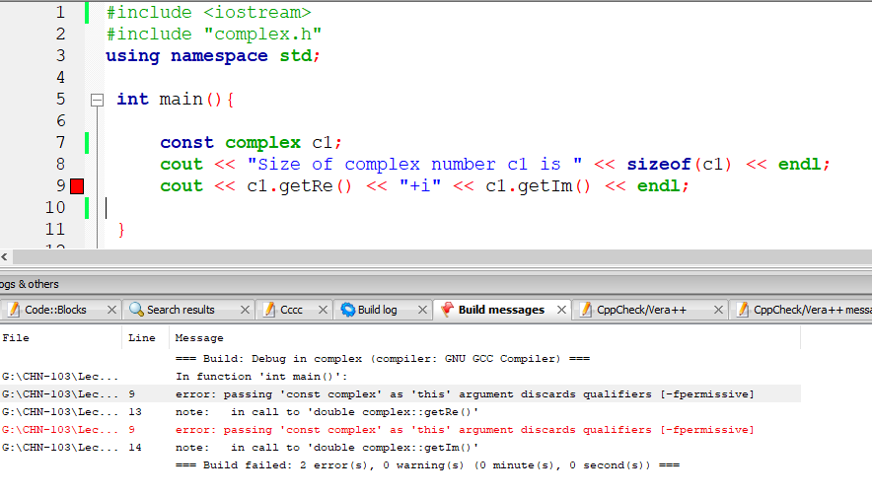
const qualifier

Slide 3
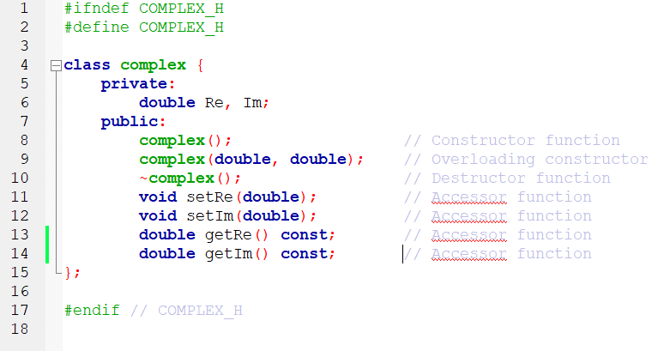
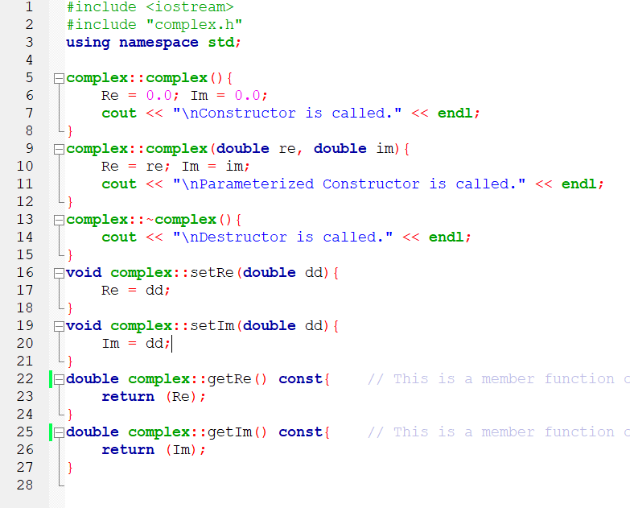
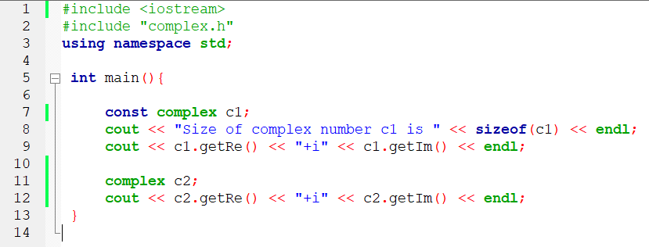
const qualifier
The functions accessing data members of const object must be declared const, which indicates the functions do not change the data values.
Once satisfied that getRe() and getIm() are only reading values, the compiler is happy handling both const and non-const objects.

Slide 4
const qualifier
The functions accessing data members of const object must be declared const, which indicates the functions do not change the data values.
Note that we didn’t assign any constant value to const object c1 when declared!!
It is okay, because constructors are run before the object is declared constant.

Slide 5
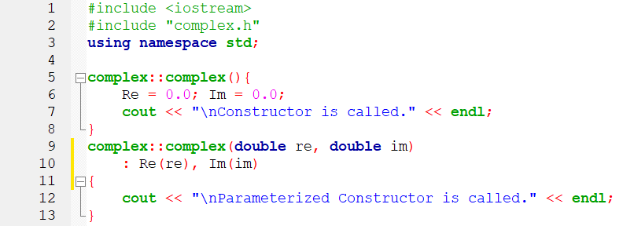
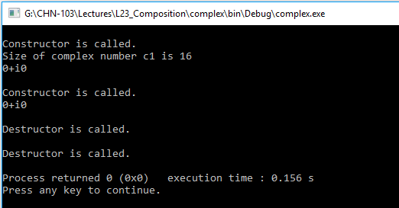
Member initializers
Member initializer list appears after the function arguments and before the start of scope and used to initialize data members.

Slide 6
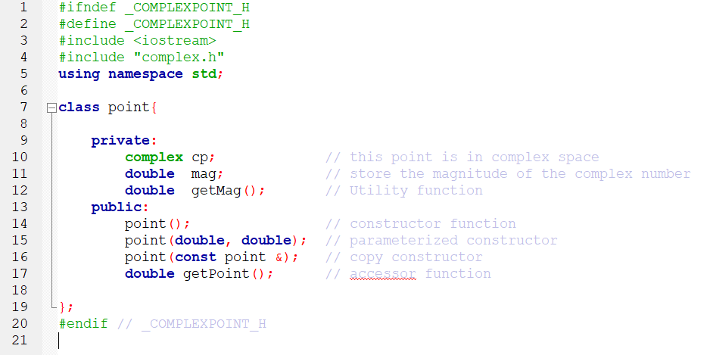
class composition
complexPoint.h
We are defining a composed class or composing a class (point) when an object of another class (complex) is used as a data member

Slide 7
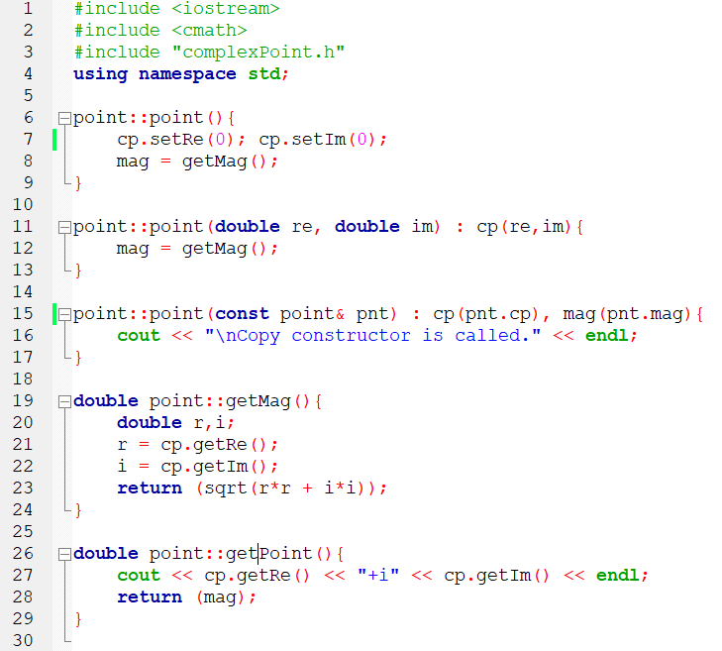
class composition
complexPoint.cpp
We are initializing data members of cp object using calls to member functions of complex class.
Same is more efficiently achieved with member initializer syntax which makes a call to constructor of complex class.
This copy constructor used copy constructor of complex class!! Made possible because compiler provides copy constructors implicitly if not defined.

Slide 8
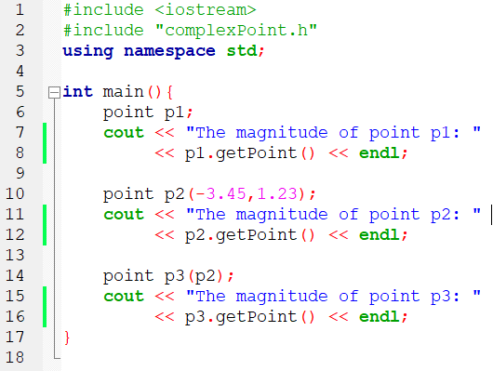
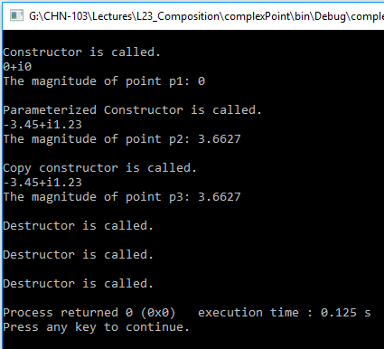
class compostion
main.cpp
Program illustrates use of all three constructors.
Note: To handle constant point objects, the getPoint() function has to be qualified with const keyword.

